Slide 1
MSP-AutoDriver Folsom Lake College Microcontroller Group Project CISP 310 - Fall 2012
Group Members:
James Daley, Henway fong, Clyde Pabro, Sang Pham

Slide 2

Our Concept
Create a self driving
programmable car.
Just like Google!
Photo courtesy of Google Images

Slide 3
Project Overview
This project outlines the educational benefits for a micro controller project in a assembly programming language class. We utilized a micro controller to program movements for a remote controlled car. With source code written in assembly language, the micro controller will direct the car to go forward, backward, turn right, and turn left without the use of a remote control. The car will be pre-programmed to do figure eights, boxing out a path, and going in a circular path; determined by button input. The goal of the project will have the car programmed for self driving utilizing an infrared sensor module. The car will detect objects in its path and determine an alternative path.

Slide 4
What are microcontrollers?
A microcontroller is a small computer on a single integrated circuit containing a processor core, memory, and programmable input and output peripheral
Popular microcontrollers include:
Arduino
PIC
MSP - 430

Slide 5
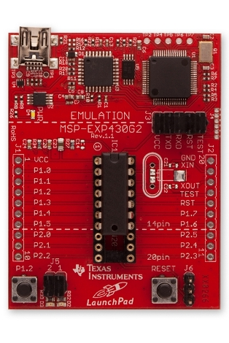
Texas Instrument MSP-430
Inexpensive micro controller
Can be programmed in C, C++, Processing, or Assembly
The model we used has 20 input/output pins
Low Voltage range 1.8 V to 3.6 V

Slide 6
Texas Instrument MSP-430
Inexpensive micro controller
Can be programmed in C, C++, Processing, or Assembly
The model we used has 20 input/output pins
Low Voltage range 1.8 V to 3.6 V
Problem we faced
It uses ARM Architecture not Intel

Slide 7
Arm Architecture / Source Code
Short for Advanced RISC Machine, previously Acorn RISC Machine
Uses RISC CPU design
Contains 16 Registers
Four dedicated registers
Twelve working registers
One 16 bits Arithmetic Logic Unit
Twenty bits address bus
But data bus is 16 bits

Slide 8
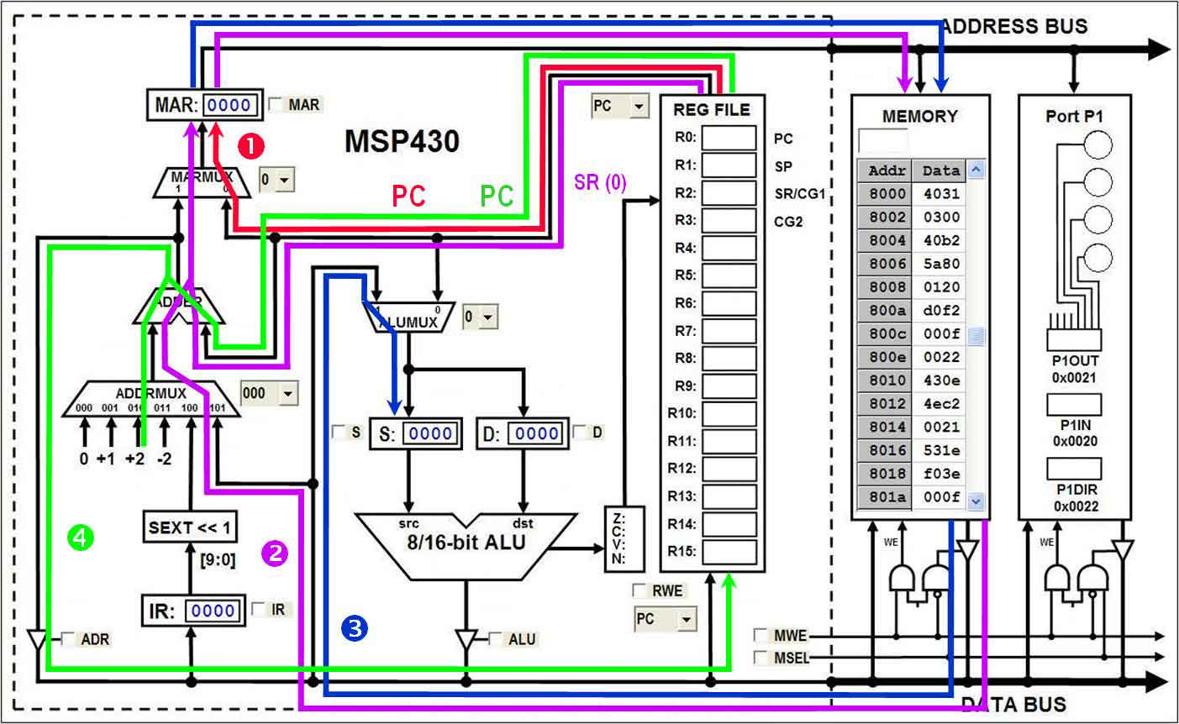
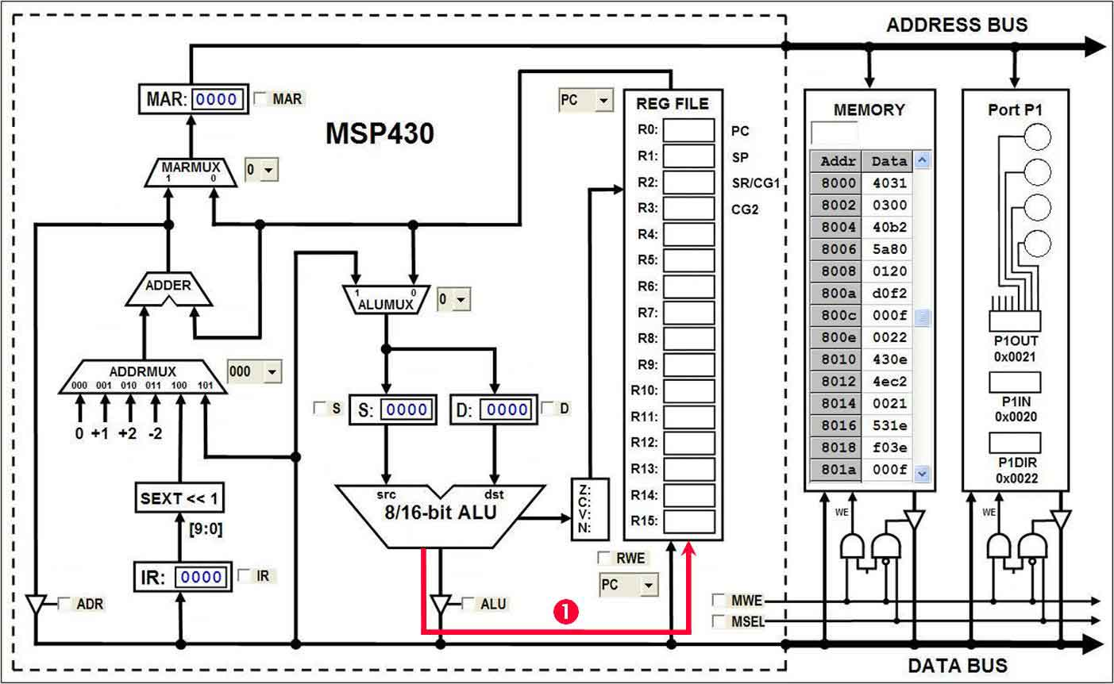

Slide 9
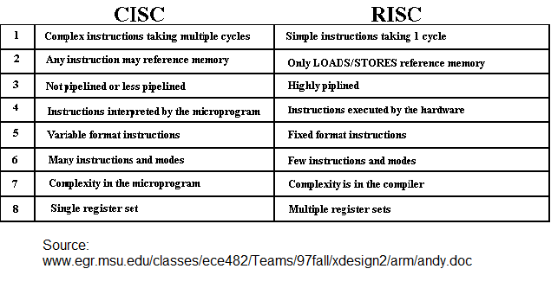

Slide 10
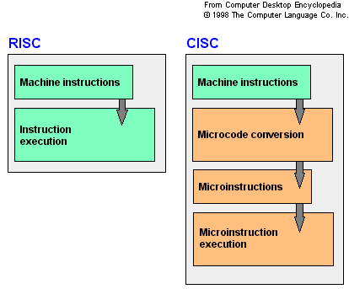

Slide 11
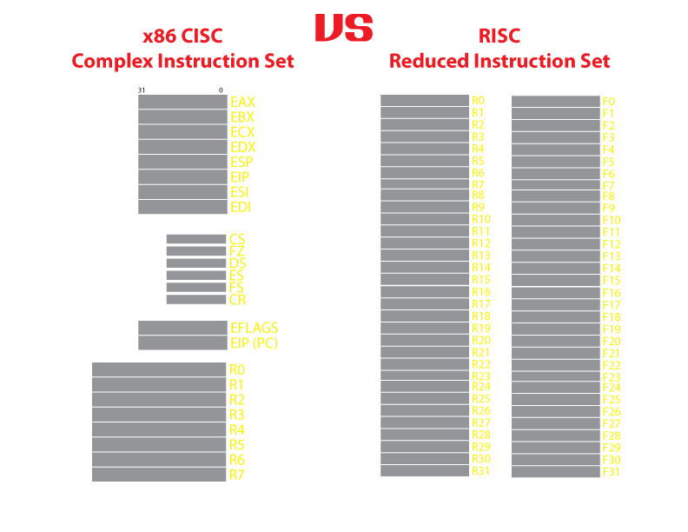

Slide 12
Dedicated Register
R0 Program Counter (PC) - point to next instruction to be read from memory and executed by the CPU
R1 Stack Pointer (SP) - can be used by user to store data by PUSH data in or POP to retrieve data
R2 Status Register (SR) - stores the state and control bits. System flag are store in SR. Used for cmp like operation
R3 Constant Generator Registers

Slide 13
General Purpose Registers
Used to store data values, address pointers, or index values
Can be accessed with byte or word instructions
Increase speed because they allow storage of frequently used values and variables instead of using memory (RAM)

Slide 14
Our Project
Parts Required:
IR Sensor
MSP - 430
Motor Controller

Slide 15
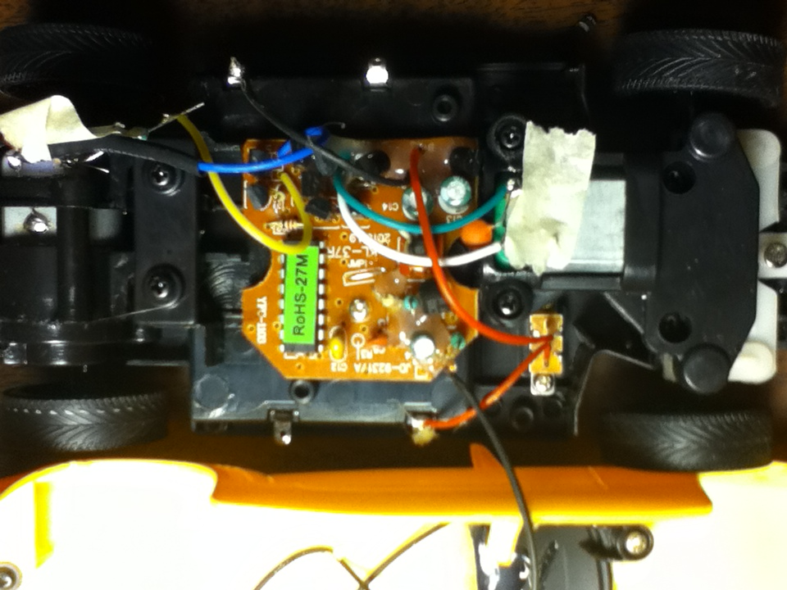
Our Project

Slide 16
Our Project
Forward
Left
Back
Right

Slide 17
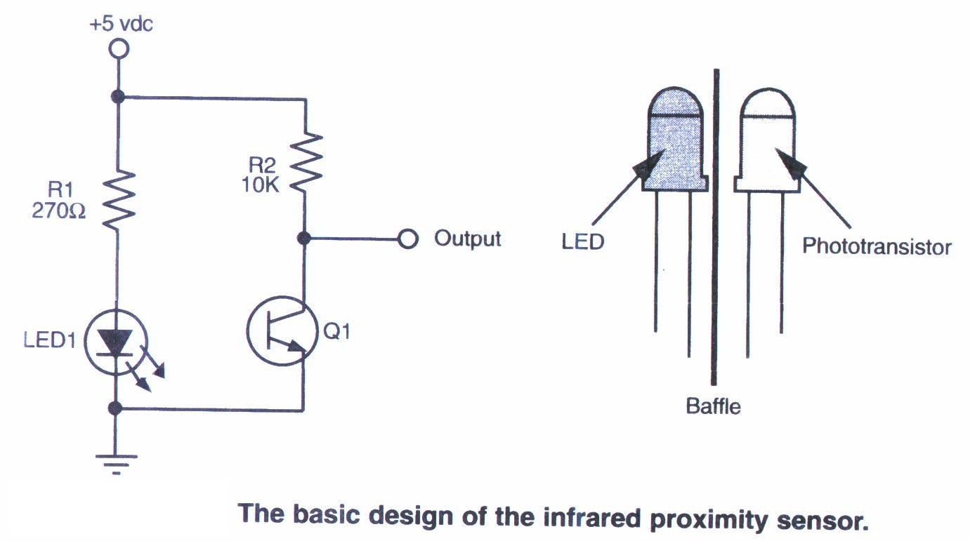
IR Sensor Diagram

Slide 18
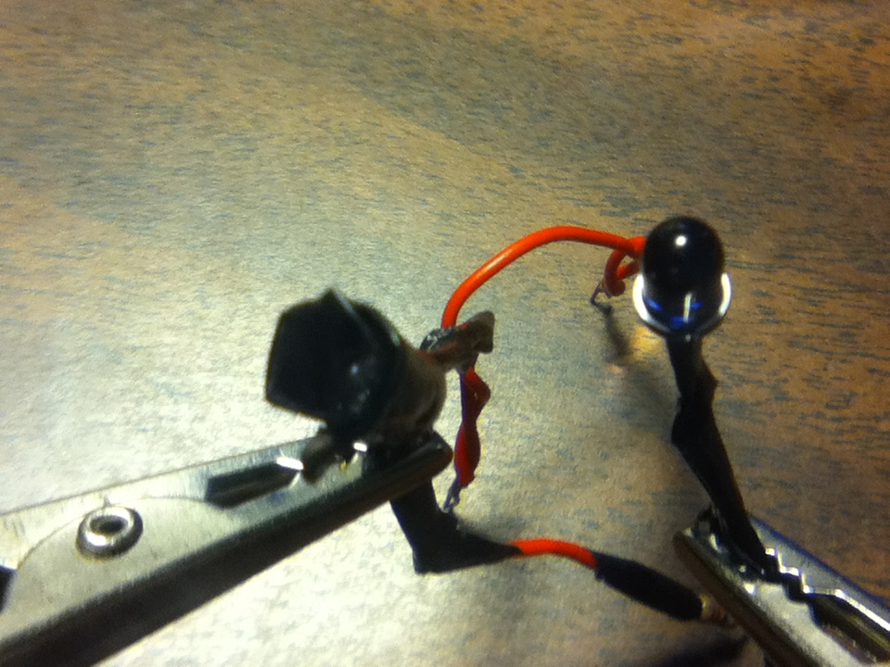
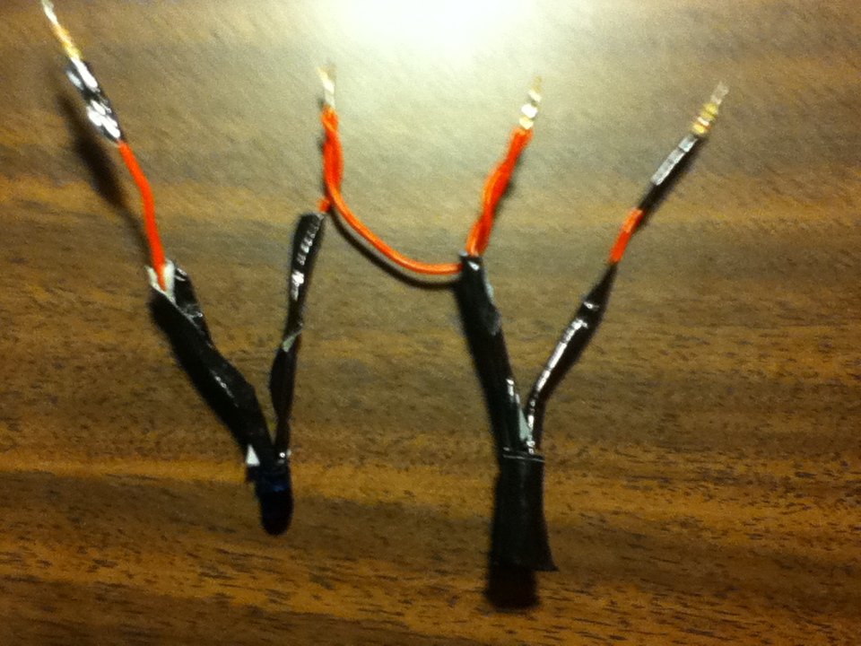
IR Sensor Prototype

Slide 19
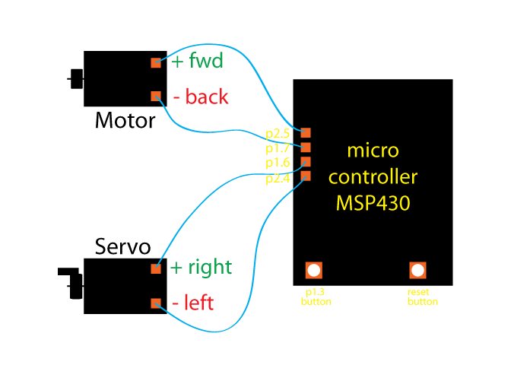

Slide 20
Breaking Down the Code
.text
.global _main
_main
;initialize stack pointer - Stack point
mov.w #0280h, SP
;stop watchdog timer - regular housekeeping
mov.w #WDTPW+WDTHOLD, &WDTCHTL
;make p1.7 and p1.6 output to control backward and right motion, and p1.3 for button press
bis.b #11001000b, &P1DIR
;make p2.5 and p2.4 output to control forward and left motion, p2.3 is also set as input
bis.b #00110000b, &P2DIR

Slide 21
mnemonic
operands
Set Bit
Pin 7 Pin 6 Pin 3
Port 1
size : byte
bis.b #11001000b, &P1DIR
Pins 0 - 7
( P1.0 to P1.7 )
On TI MSP430 Microcontroller:
Set Port 1 Pin 7 ( P1.7) to Forward Motion (Motor)
Set Port 1 Pin 6 ( P1.6) to Turn Right Motion (Servo)
P1.3 is already set for onboard Button Input

Slide 22
CarSens bit.b #00001000b, &P1IN
jc Strgth
bit.b #00001000b, &P2IN
jc Turn
Strgth bic.b #00010000b, &P2OUT
bic.b #11000000b, &P1OUT
bis.b #00100000b, &P2OUT
jmp CarSens
Turn bic.b #00100000b, &P2OUT
bic.b #11000000b, &P1OUT
bis.b #00010000b, &P2OUT
bit.b #00001000b, &P2IN
jc Turn
jmp Strgth
;test if button press
;jump to drive in a straight line if button press
;read p2.3 if sensor
;sensor is on then jump to turn the car
;clear bit to turn left to off
;clear bit to turn right and backward to off
;open bit to go forward, current allow thru
;keep going straight unless need to turn then jump to Turn
;stop the car from going straight since there is an obstacle
;clear bit to turn right and backward to off
;set bit to turn left to ON, car turn left
;read p2.3 if p2.3 is still on jump, keep turn the car
;sensor is on then jump to turn the car
;if sensor is clear then jump back to go straight

Slide 23
Other Code
bit.b #00001000b, &P1IN
&P1IN
&P1OUT
&P2IN
&P2OUT
&P1DIR
&P2DIR
bit
.b
Read or Execute
= byte
.w
bic
= word
Clear Bit
bis
Set or Initialize

Slide 24
Ending The Program
.sect ".reset"
.short _main
.end
;MSP430 RESET Vector
;some housekeeping
;end the program

Slide 25
Demonstration

Slide 26
Future Project Considerations
Why this project works:
Good potential starting project
Fun project that has tangible product as a result
Learn to use registers
Limited amount of circuit design / circuit work
What would make the project better for future students:
Separate the various components of the car
Each component would be an individual project

Slide 27


For More Information:
Group Project Information Site
Github.com/flcf12cisp310
MSP430 Sites We Referenced
http://processors.wiki.ti.com/index.php/MSP430_LaunchPad_(MSP-EXP430G2)
43oh.com
http://robotics.hobbizine.com/asmlau.html
http://www.ti.com/lit/ds/symlink/msp430g2452.pdf
Tools we used:
http://Energia.nu

Slide 28
Questions?

